Slide 1

StochasticBarrier.jl A Julia Toolbox for Stochastic Barrier Synthesis
Tit
Rayan Mazouz
Workshop on Stochastic Planning & Control of Dynamical Systems
space Engineering Sc 5, 2063

Slide 2





Problem Formulation
$$X_{u}$$
Nonlinear stochastic dynamical system
(Un)bounded support $w_{k}$
$$X_{s}$$
$x_{k+1}=f\left(x_{k}{,w}_{k}\right)$
$$X_{u}$$
$$X_{0}$$
Verification problem
Challenges
Nonlinear vector field
Stochastic process
Nonconvex safe set
$$P_{s}\left(X_{s},X_{0}, N\right)≥δ_{s}$$

Slide 3





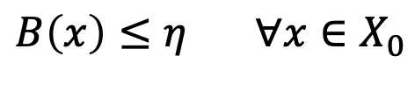







Stochastic Barrier Functions
A function $B$ is a SBF if $∃η,β≥0$ such that
$$B\left(x\right)≥0 ∀x∈ℝ^{n}$$
$$B(x)$$
$$B\left(x\right)≥1 ∀x∈X_{u}$$
$$1$$
$$B\left(x\right)≤η ∀x∈X_{0}$$
$$Ε[B\left(x_{k+1}\right)]$$
$$b_{i}$$
$$β$$
$$𝔼\left[B\left(f\left(x\right)+w\right)\right]≤B\left(x\right)+β ∀x∈X_{s}$$
$$B(x_{k})$$
$$η$$
Safety guarantee
$$X_{u}$$
$$x$$
$$X_{0}$$
$P_{s}≥1−$ $(η+β N)$

Slide 4
Stochastic Barrier Functions
Toolbox: https://github.com/aria-systems-group/StochasticBarrier.jl
Sum of Squares optimization
Piecewise stochastic barrier functions
Theory and comparison:
Mazouz et al. ”Piecewise Stochastic Barrier Functions”

Slide 5
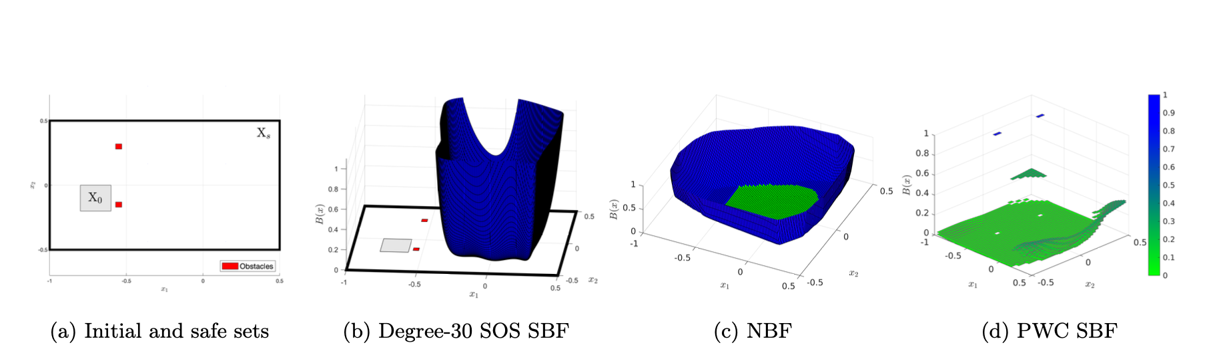



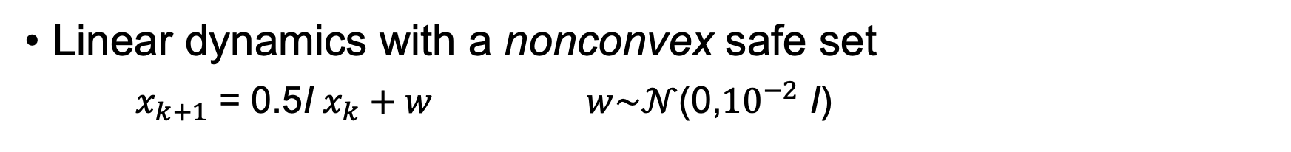
Case Studies: Highlights
Linear dynamics with a nonconvex safe set
$x_{k+1}$ = 0.5I $x_{k}+w$ $w\sim 𝒩$(0,${10}^{−2}$ I)
$$P_{s}≥0.07$$
$$P_{s}≥0.92$$
$$P_{s}≥0.93$$

Slide 6
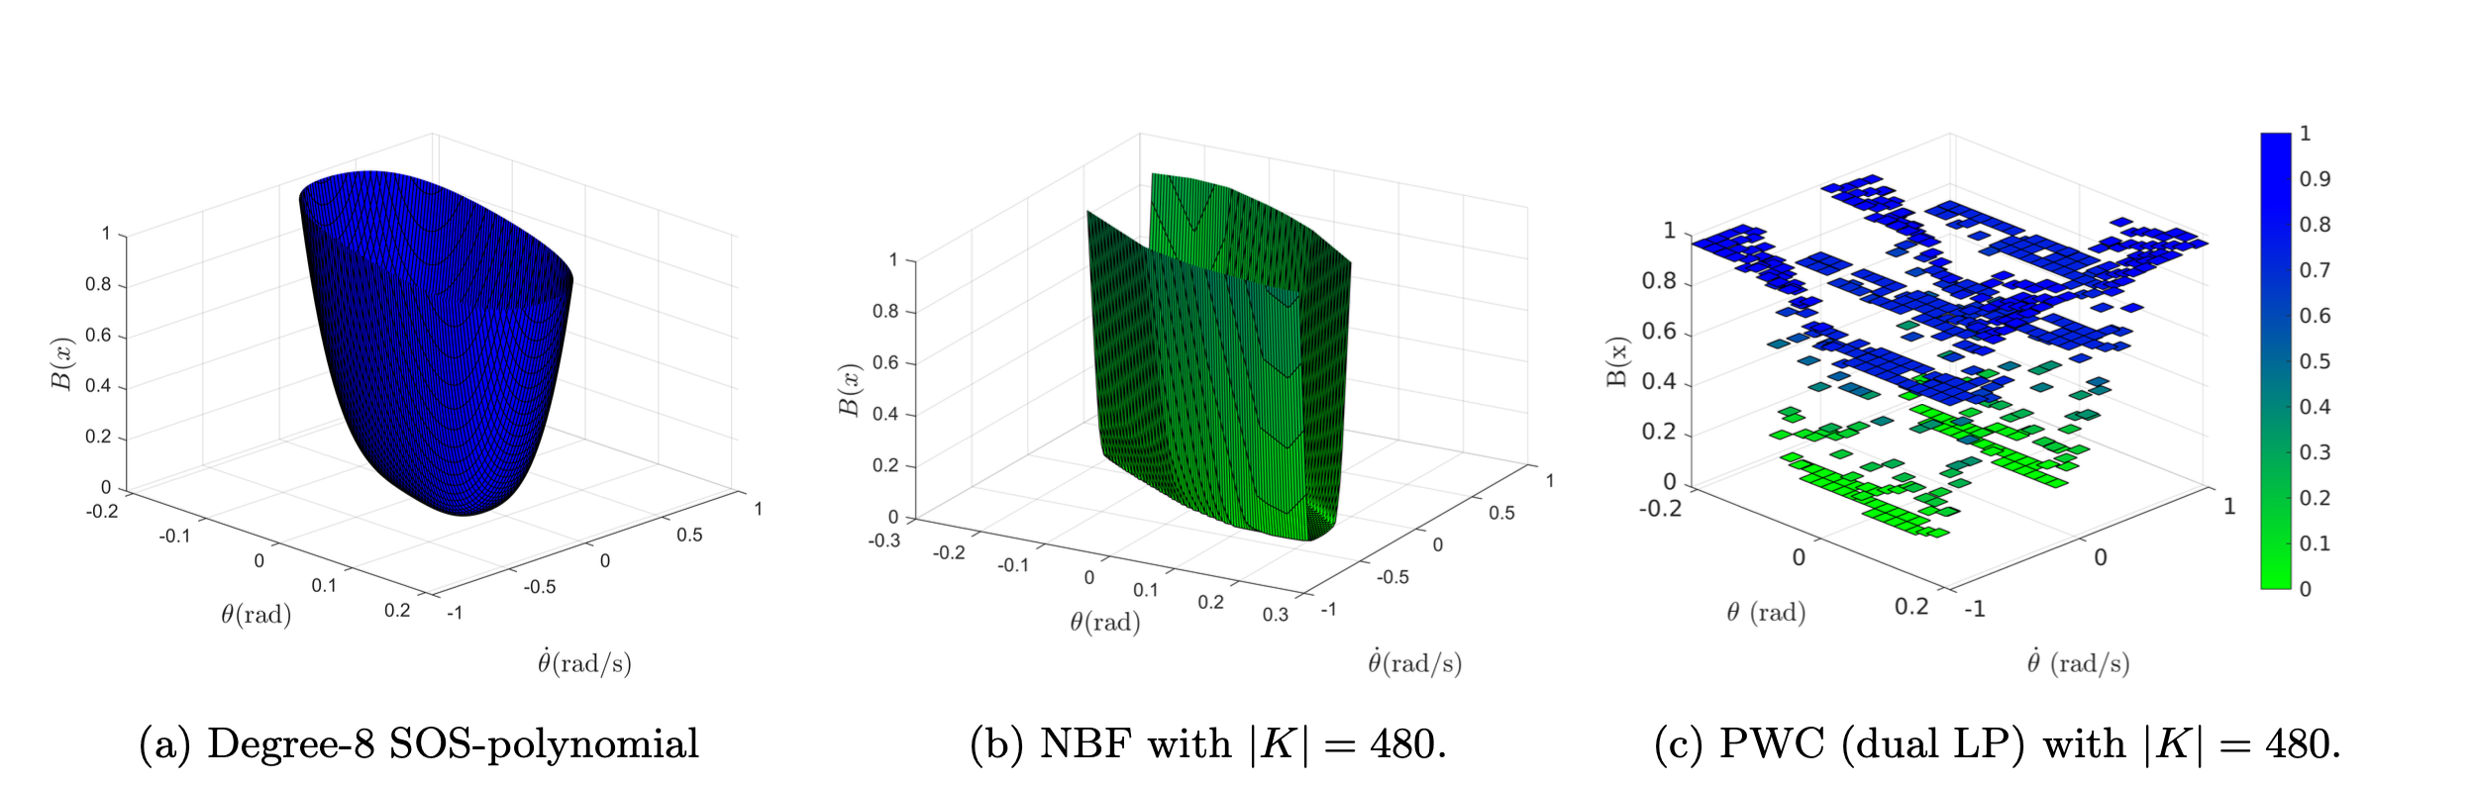



Case Studies: Highlights
Pendulum model with a convex safe set
Closed-loop neural network controller
$$P_{s}≥0.99$$
$$P_{s}≥0.99$$
$$P_{s}≥0.99$$

Slide 7
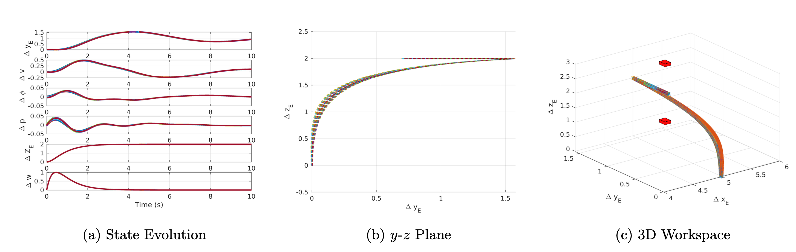

Case Studies: Highlights
Lateral quadrotor model with a nonconvex safe set
Sum-of-Squares: $P_{s}≥0.00$
Piecewise Barrier: $P_{s}≥0.90$

Slide 8


Thanks!
NeurIPS 22
Automatica 25 Preprint
rayan.mazouz@colorado.edu

